Slide 1
GROUP MEMBERS: Malaika Zafar Isma Abbasi Noshaba Khan SUBMITTED TO: MAM SADIA ZAR
In the name of Allah the most beneficent, the most merciful.

Slide 2
Topics:
Cyber warfare
Distributed defense
Homeland security
Insecure Session Management
CSRF

Slide 3
CYBER WARFARE

Slide 4
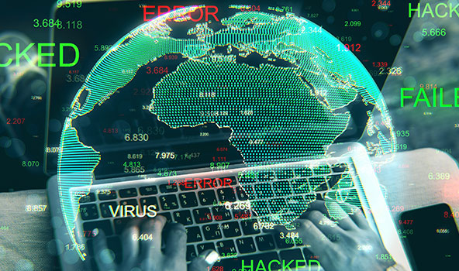
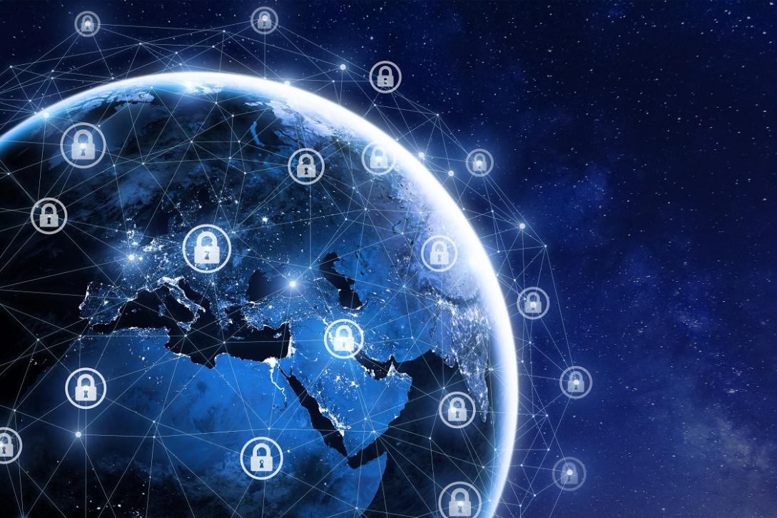

CYBER WARFARE…. IS IT SERIOUS???
TACTICS
CYBERSPACE
HOSTILE FORCE
Means and tools to achieve success by inflicting maximum collateral damage your opponent.
the complex environment resulting from the interaction of people, software
The term “hostile force or person” means any nation, any subject of a foreign nation, or any other person serving a foreign nation

Slide 5
What Is Cyber Warfare?
Cyber warfare is usually defined as a cyber attack or series of attacks that target a country. It has the potential to wreak havoc on government and civilian infrastructure and disrupt critical systems, resulting in damage to the state and even loss of life.

Slide 6
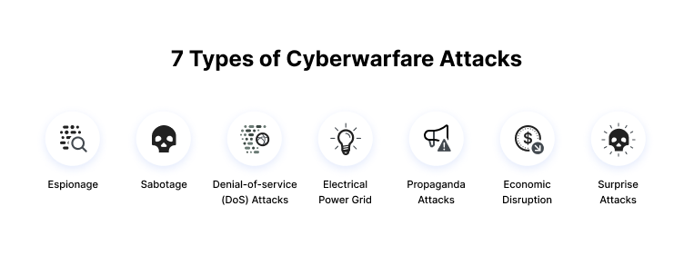
7 Types of Cyber Warfare Attacks

Slide 7
Espionage
Refers to monitoring other countries to steal secrets. In cyber warfare, this can involve using botnets or spear phishing attacks to compromise sensitive computer systems before exfiltrating sensitive information.
Sabotage
Government organizations must determine sensitive information and the risks if it is compromised. Hostile governments or terrorists may steal information, destroy it, or leverage insider threats such as dissatisfied or careless employees, or government employees with affiliation to the attacking country.

Slide 8
Denial-of-service (DoS) Attacks
DoS attacks prevent legitimate users from accessing a website by flooding it with fake requests and forcing the website to handle these requests. This type of attack can be used to disrupt critical operations and systems and block access to sensitive websites by civilians, military and security personnel, or research bodies.

Slide 9
Electrical Power Grid
Attacking the power grid allows attackers to disable critical systems, disrupt infrastructure, and potentially result in bodily harm. Attacks on the power grid can also disrupt communications and render services such as text messages and communications unusable.
Propaganda Attacks
Attempts to control the minds and thoughts of people living in or fighting for a target country. Propaganda can be used to expose embarrassing truths, spread lies to make people lose trust in their country, or side with their enemies.

Slide 10
Economic Disruption
Most modern economic systems operate using computers. Attackers can target computer networks of economic establishments such as stock markets, payment systems, and banks to steal money or block people from accessing the funds they need.
Surprise Attacks
These are the cyber equivalent of attacks like Pearl Harbor and 9/11. The point is to carry out a massive attack that the enemy isn’t expecting, enabling the attacker to weaken their defenses. This can be done to prepare the ground for a physical attack in the context of hybrid warfare.

Slide 11
Examples of Cyber Warfare Operations

Slide 12
Sony Pictures Hack
An attack on Sony Pictures followed the release of the film “The Interview”, which presented a negative portrayal of Kim Jong Un. The attack is attributed to North Korean government hackers. The FBI found similarities to previous malware attacks by North Koreans, including code, encryption algorithms, and data deletion mechanisms.

Slide 13
Bronze Soldier
In 2007, Estonia relocated a statue associated with the Soviet Union, the Bronze Soldier, from the center of its capital Tallinn to a military cemetery near the city. Estonia suffered a number of significant cyber attacks in the following months. Estonian government websites, media outlets, and banks were overloaded with traffic in massive denial of service (DoS) attacks and consequently were taken offline.

Slide 14
Fancy Bear
Crowd Strike claims that the Russian organized cybercrime group Fancy Bear targeted Ukrainian rocket forces and artillery between 2014 and 2016. The malware was spread via an infected Android application used by the D-30 Howitzer artillery unit to manage targeting data.
Ukrainian officers made wide use of the app, which contained the X-Agent spyware. This is considered to be a highly successful attack, resulting in the destruction of over 80% of Ukraine’s D-30 Howitzers.

Slide 15
Enemies of Qatar
Elliott Broody, an American Republican fundraiser, sued the government of Qatar in 2018, accusing it of stealing and leaking his emails in an attempt to discredit him. The Qataris allegedly saw him as an obstacle to improving their standing in Washington.
According to the lawsuit, the brother of the Qatari Emir was alleged to have orchestrated a cyber warfare campaign, along with others in Qatari leadership. 1,200 people were targeted by the same attackers, with many of these being known “enemies of Qatar”, including senior officials from Egypt, Saudi Arabia, the United Arab Emirates, and Bahrain.

Slide 16
How to Combat Cyber Warfare
Conducting Risk Assessments with Cyber Wargames
Testing different situations
Testing unusual scenarios
Division of labor and cooperation mechanisms
Improving policies

Slide 17
Cont…
The Importance of Layered Defense
Securing the cyber ecosystem
Raising awareness for cyber security
Promoting open standards for combating cyber threats
Implementing a national cyber security assurance framework
Working with private organizations to improve their cyber security capabilities
Securing the Private Sector

Slide 18
DISTRIBUTED DEFENSE

Slide 19
Distributed Defense: New Operational Concepts for Air and Missile Defense
Despite the rising salience of missile threats, current air and missile defense forces are far too susceptible to suppression. Today’s U.S. air and missile defense (AMD) force lacks the depth, capacity, and operational flexibility to simultaneously perform both missions.

Slide 20
Distributed Defense approach
The Distributed Defense approach includes seven notional concepts that build on one another in roughly sequential order:
1. Network centrism: “any sensor, best shooter”
2. Element dispersal: “redefine the firing unit”
3. Mixed loads: “layered defense in a box”
4. Offense-defense launchers: “any launcher, any mission”
5. Multi-mission shooters: “any missile, any target”
6. Containerized launchers: “any launcher, anywhere”
7. Passive defense shell game: “some full, many empty“
Distributed Defense proposes to create an AMD architecture that would be more flexible and resilient, bolster power projection, impose costs on potential adversaries, and complicate adversary planning.

Slide 21
History
September 11, 2001 : Terrorist attack America.
October 8, 2001: President George W. Bush creates White House Office of Homeland Security.
June 2002: President George W. Bush introduce to congress his proposal for a new Department.
November 2002: Congress passes the Homeland Security Bill.
November 25, 2002: President Bush signs the Homeland Security act into Law.
January 24, 2003: The Department of Homeland Security(DHS) is born.
March 1, 2003: Majority of the affected agencies join the new Department of house Security.

Slide 22
Homeland Security
What is Homeland Security?
The United States Department of Homeland Security (DHS) is a federal agency designed to protect the United States

Slide 23
What Does DHS?
Prevent terrorist attacks within the United States.
Reduce America‘s Vulnerability to terrorism.
The DHS is responsible for public security such as:
Border security,
Cyber security,
Disaster prevention
Economy security

Slide 24
5 Mission key Focus Area of DHS
Intelligence And Warming system
Protecting Border and Transport
Protect Critical Infrastructure
Secure Cyberspace and Critical Infrastructure
Emergency preparedness and Response

Slide 25
Mission of Intelligence And warning
The DHS understand the Intelligence is an integral component of the overall effort to reduce the nation’s vulnerability to terrorism. And the Warning mission creates and intelligence and warning system that can detect the terrorist activity before it happens, is a sure way to minimize the risk of an attack. DHs has also a number of strategic initiatives to support their mission with intelligence and warning . These include working with the FBI to hire intelligence analysts with specialized expertise, such as : computer expert, foreign language capacity and science and engineering backgrounds, and also “red team” techniques to improve the department’s capability of detecting terrorism

Slide 26
Mission of Border and transport security
America’s borders total 7000 miles of land with Canada and Mexico, as well as coastlines, lakes, rivers which also fall under DHS. DHS main purpose monitoring these areas 24 hour a day, is essential to reduce the illegal movement of people, drugs, weapons.
DHS secures the America’s borders through the deployment of technology .
The Department of Homeland Security would be responsible for securing our nation’s borders and transportation systems. The Department would manage who and what enters our homeland, and work to prevent the entry of terrorists and the instruments
Some achievements since the creation of DHS, include a 53% reduction in illegal immigration, 41% more drugs seized, 159% weapons seized.

Slide 27
Mission of protect critical infrastructure
Critical infrastructure provides the services that are the backbone of our national and economic security and the health and well-being of all Americans.
There are 16 critical infrastructure sectors that are considered important to the US, if they are compromised in any way, the result would have a debilitating effect on the nation security and public health safety.

Slide 28
Critical infrastructure sectors
energy,
communications,
transportation,
dams,
manufacturing,
financial services,
food,
agriculture,
Transportation system
financial services,
emergency services,
government facilities,
information technology,
healthcare,
Chemical
Water
Nuclear reactors.

Slide 29
Mission of Emergency preparedness and Response
DHS will also react to natural disasters that impact millions of American in a year.
The federal emergency of management agency (FEMA), is a team within the department that work for Emergency preparedness and response.
The FEMA efforts for:
Helping communities reduce their risks.
Support emergency services prepare for accident and natural disasters
And helping people to get back to normal when their lives are turned by disaster.

Slide 30
Insecure Session Management
Insecure session cookies:
Insecure session cookies are easy for hackers to predict or to use for brute-force attacks. If a hacker can spoof your users’ session IDs, they can impersonate users and take over their accounts. This is known as session hijacking, and it can lead to the loss of sensitive information connected to the account.
If the Session is not maintained properly at server side then it’s insecure session management and attackers easily exploit it.
if the session management is not properly done by the developers then an attacker may take the advantage of it and can compromise the user session which results in ATO(account take over).

Slide 31
Insecure session cookies:
Weak session token with very low entropy has been assigned.
Example:
Suppose an application is assigning the session key with very low entropy and that in the in numeric value, for example the session key assigned to the user 1 is 00001 and the session key assigned to the user 2 is 00002 so attacker can easily brute force the session ID and get the access to the legit user’s account.

Slide 32
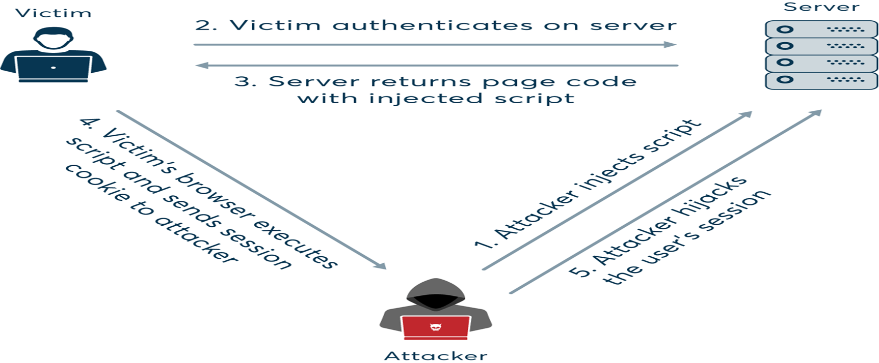

Slide 33
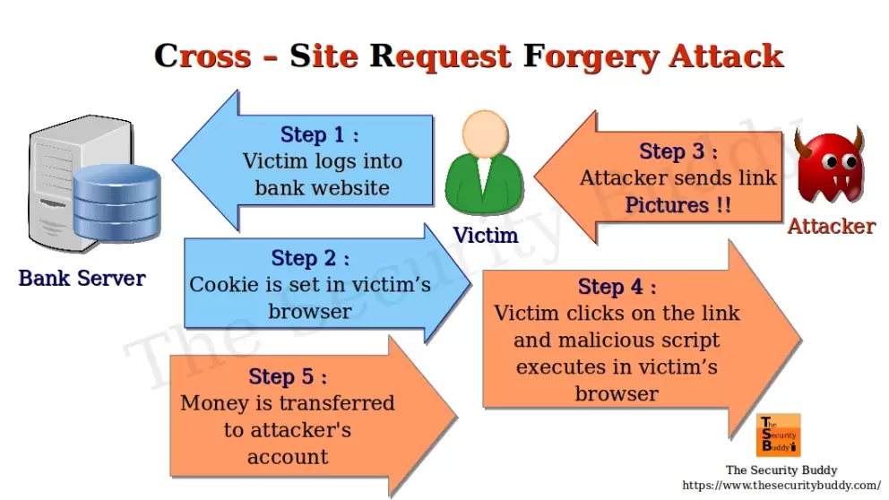
CSRF(Cross site request Forgery)
What is CSRF(Cross site request Forgery)?
A Cross-site request forgery hole is when a malicious site can cause a visitor’s browser to make a request to your server that causes a change on the server.
The server thinks that because the request comes with the user cookies, the user wanted to submit that form.

Slide 34
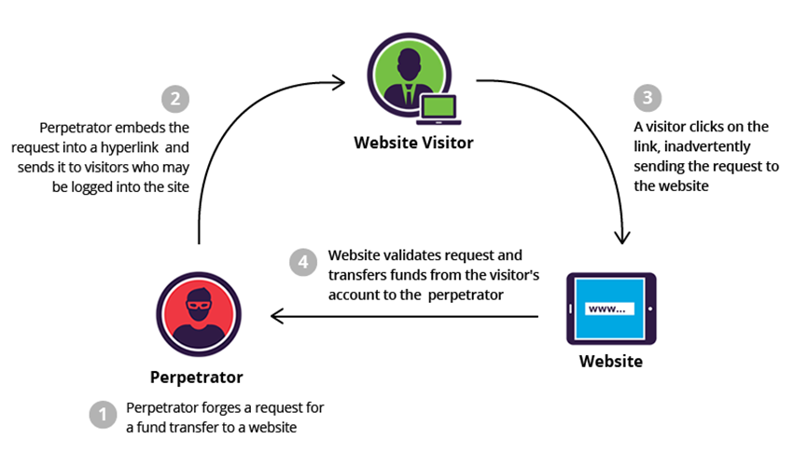
What is the impact of a CSRF attack?
In a successful CSRF attack, the attacker causes the victim user to carry out an action unintentionally.
For example, this might be to change the email address on their account, to change their password, or to make a funds transfer.
Depending on the nature of the action, the attacker might be able to gain full control over the user's account. If the compromised user has a privileged role within the application, then the attacker might be able to take full control of all the application's data and functionality.

Slide 35
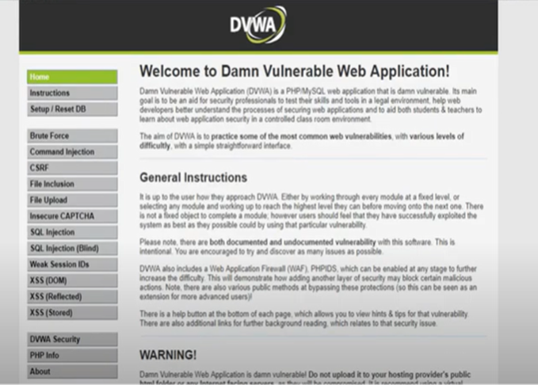
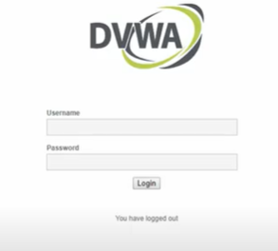
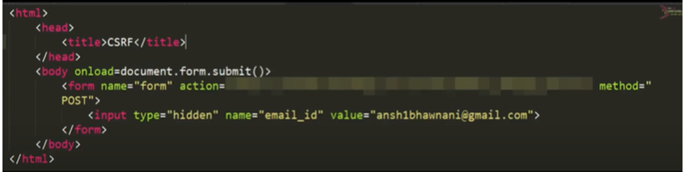
Apply CSRF attack on vulnerable website

Slide 36
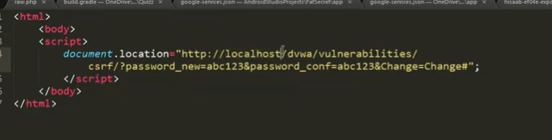
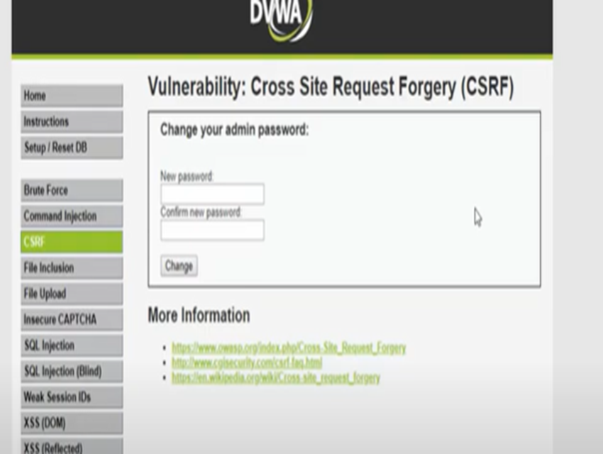
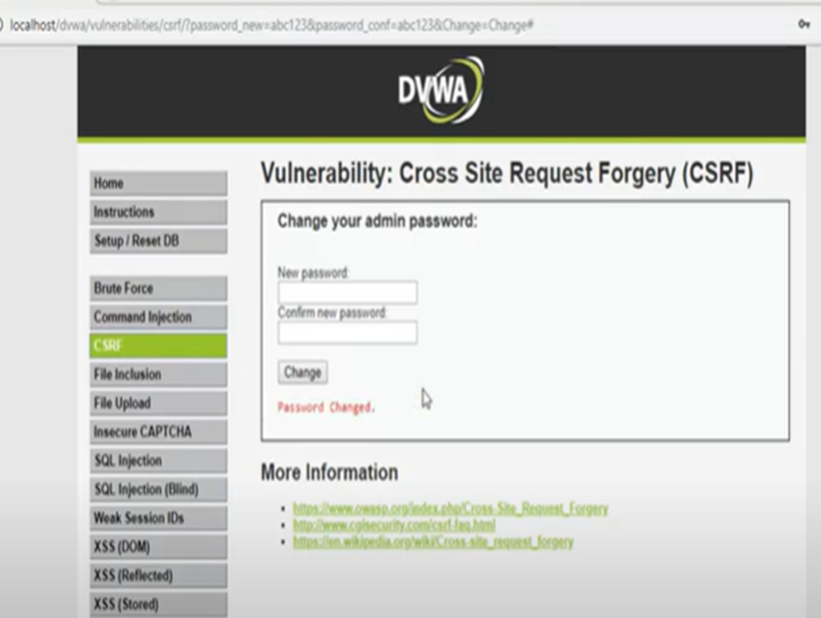
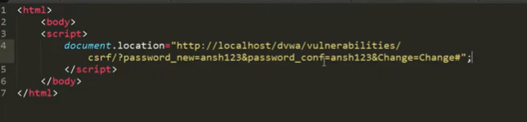
Cont....

Slide 37
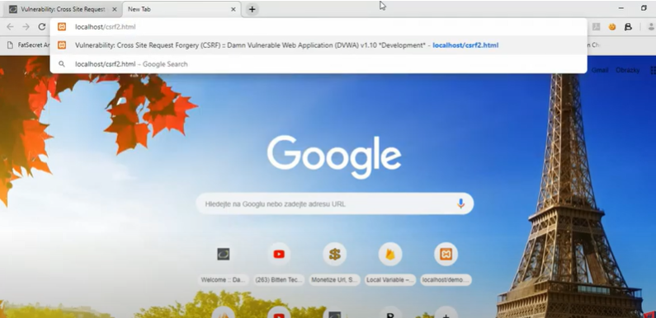
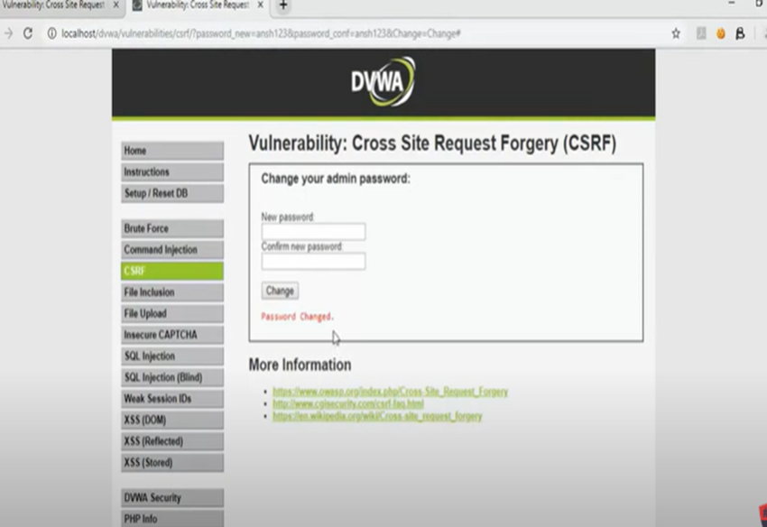
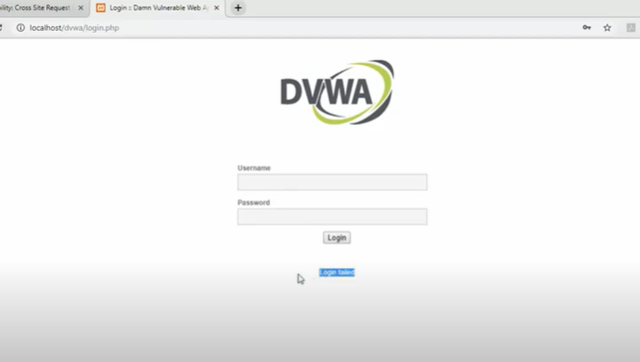

Slide 38
Common defenses against CSRF
Nowadays, successfully finding and exploiting CSRF vulnerabilities often involves bypassing anti-CSRF measures deployed by the target website, the victim's browser, or both. The most common defenses you'll encounter are as follows:

Slide 39
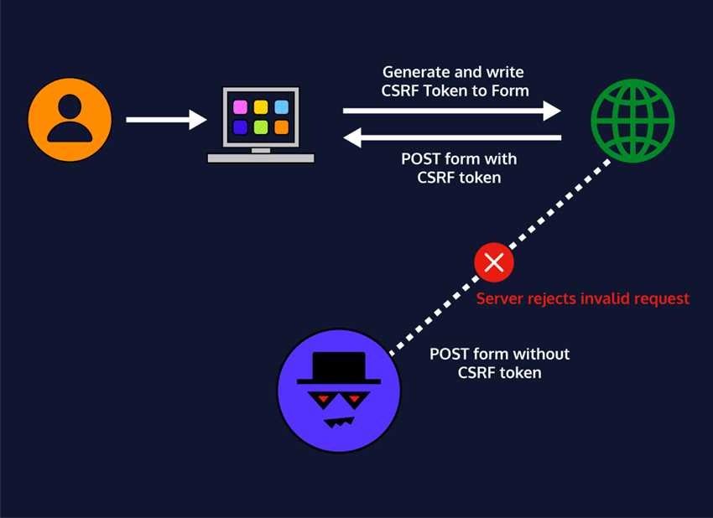
CSRF tokens
A CSRF token is a unique, secret, and unpredictable value that is generated by the server-side application and shared with the client. When attempting to perform a sensitive action, such as submitting a form, the client must include the correct CSRF token in the request. This makes it very difficult for an attacker to construct a valid request on behalf of the victim, and more Same Site cookies etc.

Slide 40
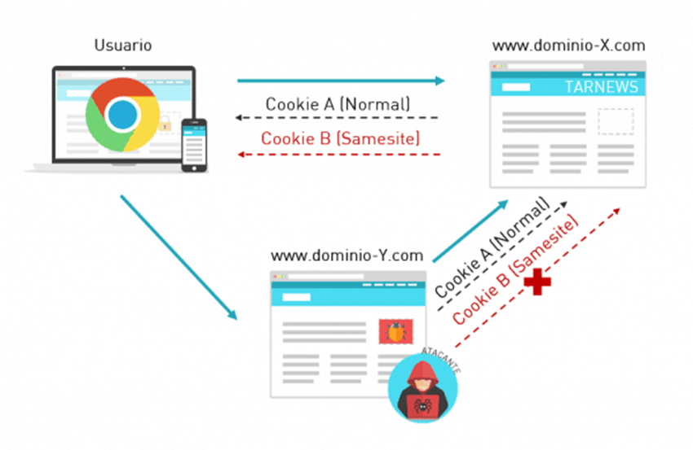
Same Site cookies
Same Site is a browser security mechanism that determines when a website's cookies are included in requests originating from other websites. As requests to perform sensitive actions typically require an authenticated session cookie, the appropriate Same Site restrictions may prevent an attacker from triggering these actions cross-site. Since 2021, Chrome enforces Lax Same Site restrictions by default. As this is the proposed standard, we expect other major browsers to adopt this behavior in future.

Slide 41
Thanks For Your Concentration😎

